Slide 1
PC Controller Using Android Device

Slide 2
Our Guide
Mr. Antosh Dayde. (Department Of CSE)
Our Team
1.Atharv Milind Davale. (Roll no: 38)
2.Digvijay Sambhaji Shinde. (Roll no: 63)
3.Rushikesh Rajesh Waghule. (Roll no: 73)
4.Amrut Yogesh Virdhe. (Roll no: 69)
5.Abhijeet Balkrishna surshetwar. (Roll no: 66)

Slide 3
Introduction
There a few several situations where we want to wirelessly and comfortably operate a computer, where the computer screen is design onto a big screen through a projector or big-screen television, such as classrooms, conference/meeting rooms, mobile, workgroup project and even living rooms.
Several specifically designed devices are available on the market for the goal of operating computers remotely and wirelessly. Wireless keyboard, uses each of two Bluetooth or wireless USB mini-receiver plugged into the USB port of computer for the communication among the keyboard and the computer.
Wireless presentation controller, allows user to operate his/her computer remotely for PowerPoint presentation over Bluetooth connection.

Slide 4
Problem Statement
To create android app that establish connection between laptops ,computers and android device using wifi and allows use of android smartphones touchpad as mouse and phone as wireless keyboard to control laptops and computers Wirelessly.

Slide 5
Objective
Touch-screen mouse control with two onscreen mouse buttons.
Use in either portrait or landscape mode.
Works with any Wi-Fi network.
Keyboard typing capability.
Support any Android operating system version.
Compatible with Mac, Windows and Linux operating systems.
it can be used for showing live coding demo.

Slide 6
Technology Platform
Mobile Platform : Android
Application development framework : Android (Android Studio)
Developing language : JAVA
User Interface Language: XML
Android API level : 10 and above
Wireless Communication Medium : WIFI

Slide 7
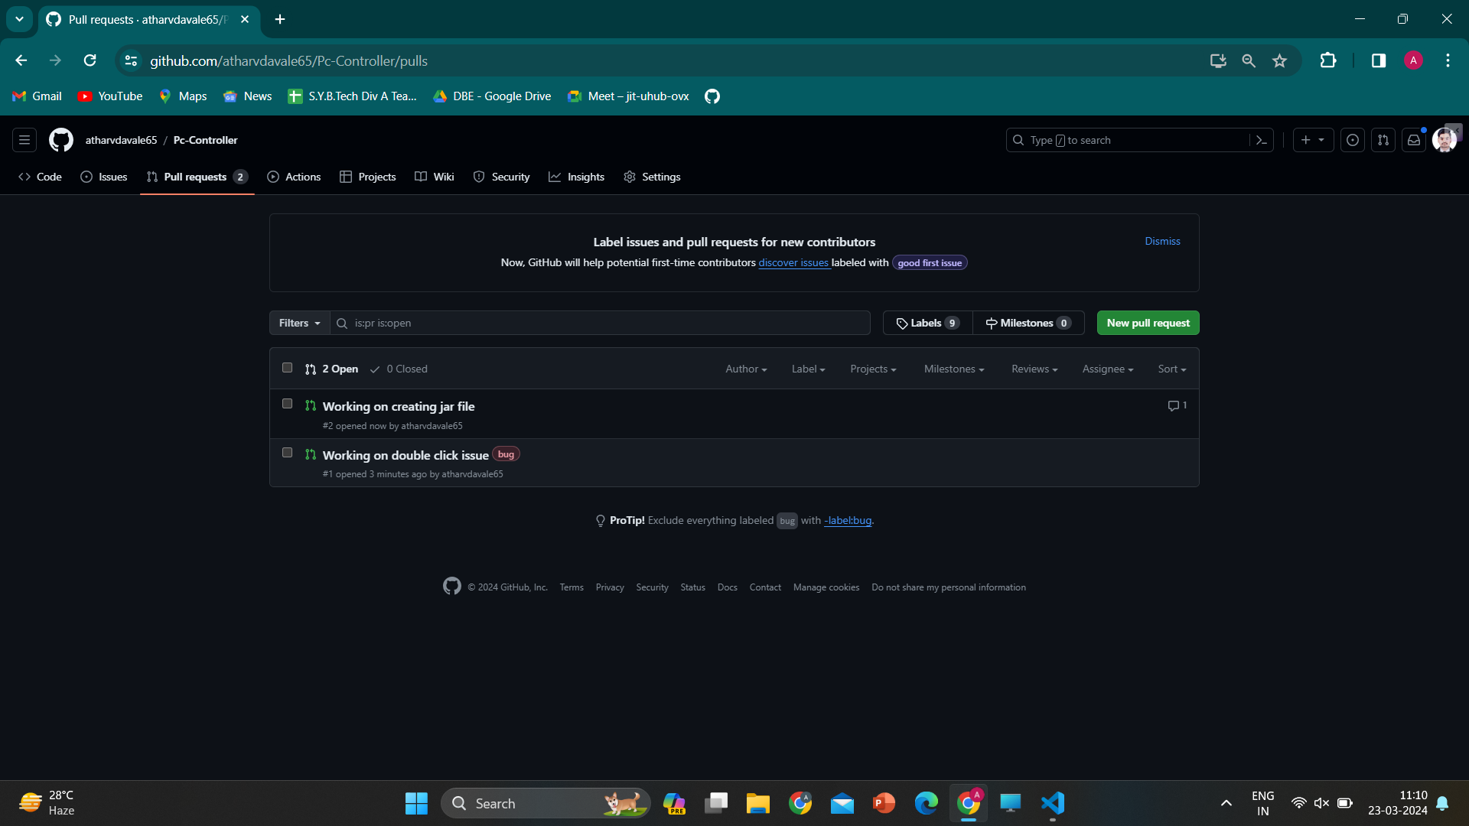
Git for version control

Slide 8
Advantages
Eliminate need of hardware: The use of wireless pc control android app eliminate need of carry wireless hardware such as mouse keyboard.
Accessibility: You can easily connect app with less efforts and faster setup. No need to pair and connect device to pc and laptop every time.
Real Time performance: The our app is using wifi based communication that makes low latency and almost less than 20ms latency to perform actions which provides smoother experience to user.
Remote Control:
1.Convenience: You can control your PC from a distance, eliminating the need to be physically present at your computer.
2.Flexibility: Allows you to control your PC from different rooms or locations within the range of your network.
5. User Friendly Interface: The development of an intuitive user interface ensures that the system is accessible and easy to use for individuals.

Slide 9
Algorithm ad Strategies used
InterProcess Communication
Socket Programming
Wi-Fi Technology

Slide 10
InterProcess Communication
1. InterProcess Communication (IPC) is a set of methods for the exchange of data among multiple threads in one or more processes. IPC methods are divided into methods for message passing, synchronization, shared memory, and remote procedure calls (RPC).
2. There are several reasons for providing an environment that allows process cooperation:
Information sharing
Computational speed
Convenience
Privilege separation

Slide 11
Socket Programming
A socket is a bidirectional communication device that can be used to communicate with a process running on other machines. Sockets are the only InterProcess
Socket programming is a method of communication between two computers using a network protocol. Sockets provide a standard mechanism for processes on different devices to communicate over a network
Normally, a server runs on a specific computer and has a socket that is bound to a specific port number

Slide 12
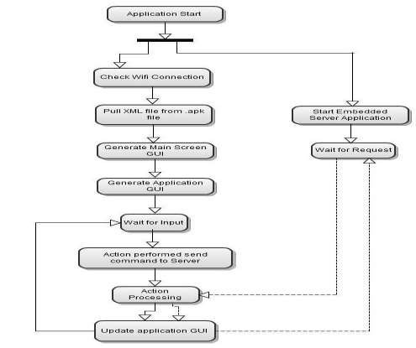
Methodology
(Android application flow)

Slide 13
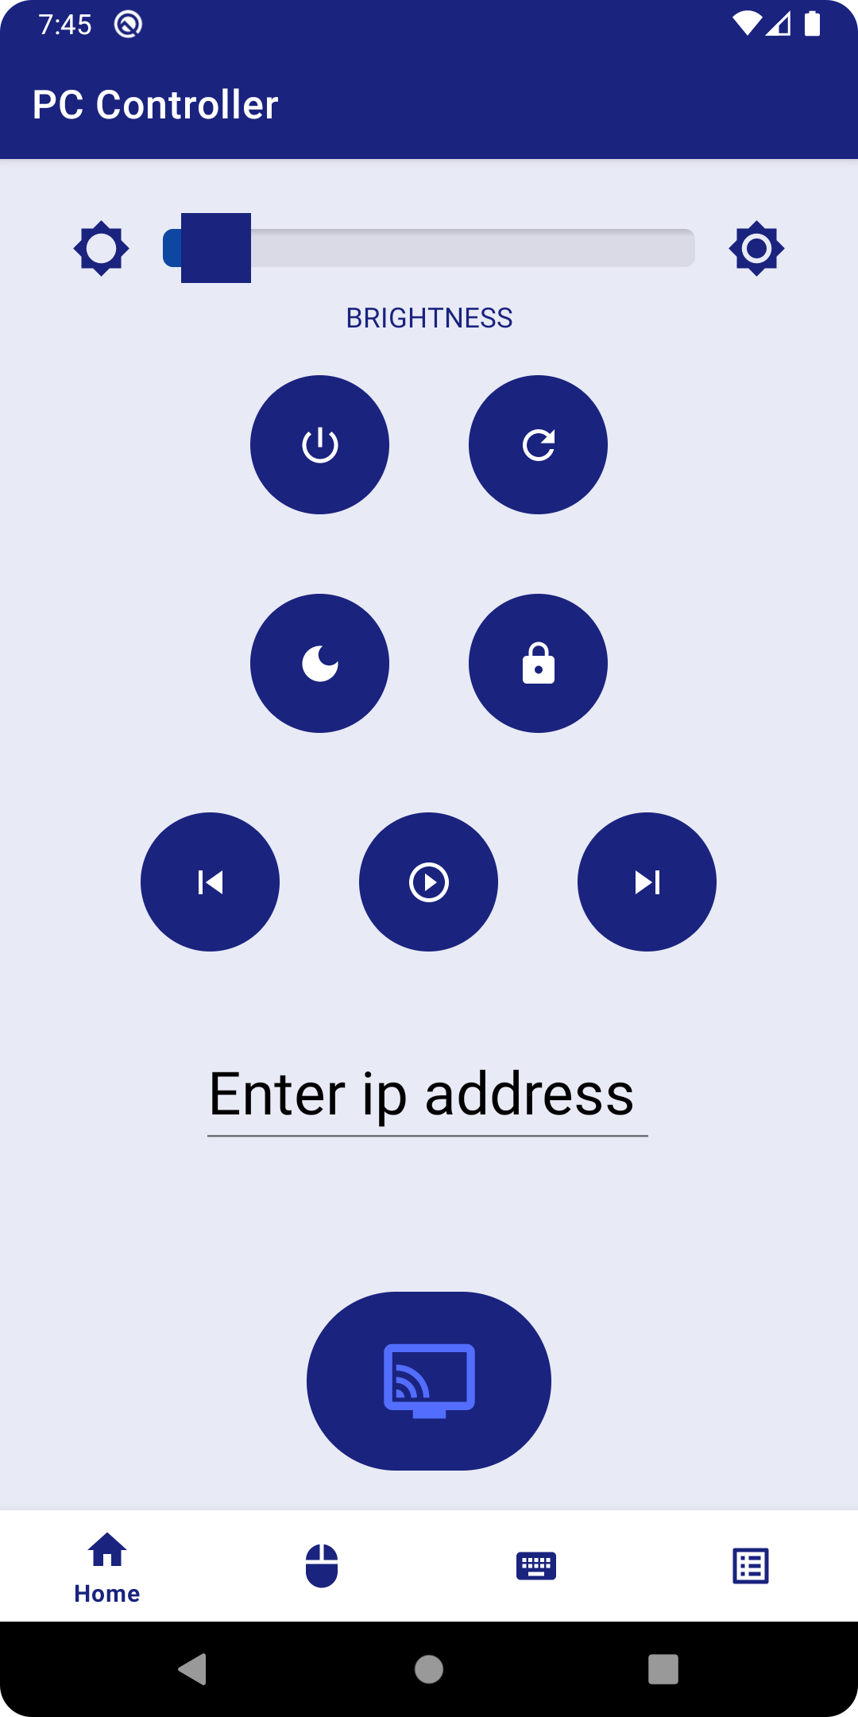
Home Page

Slide 14
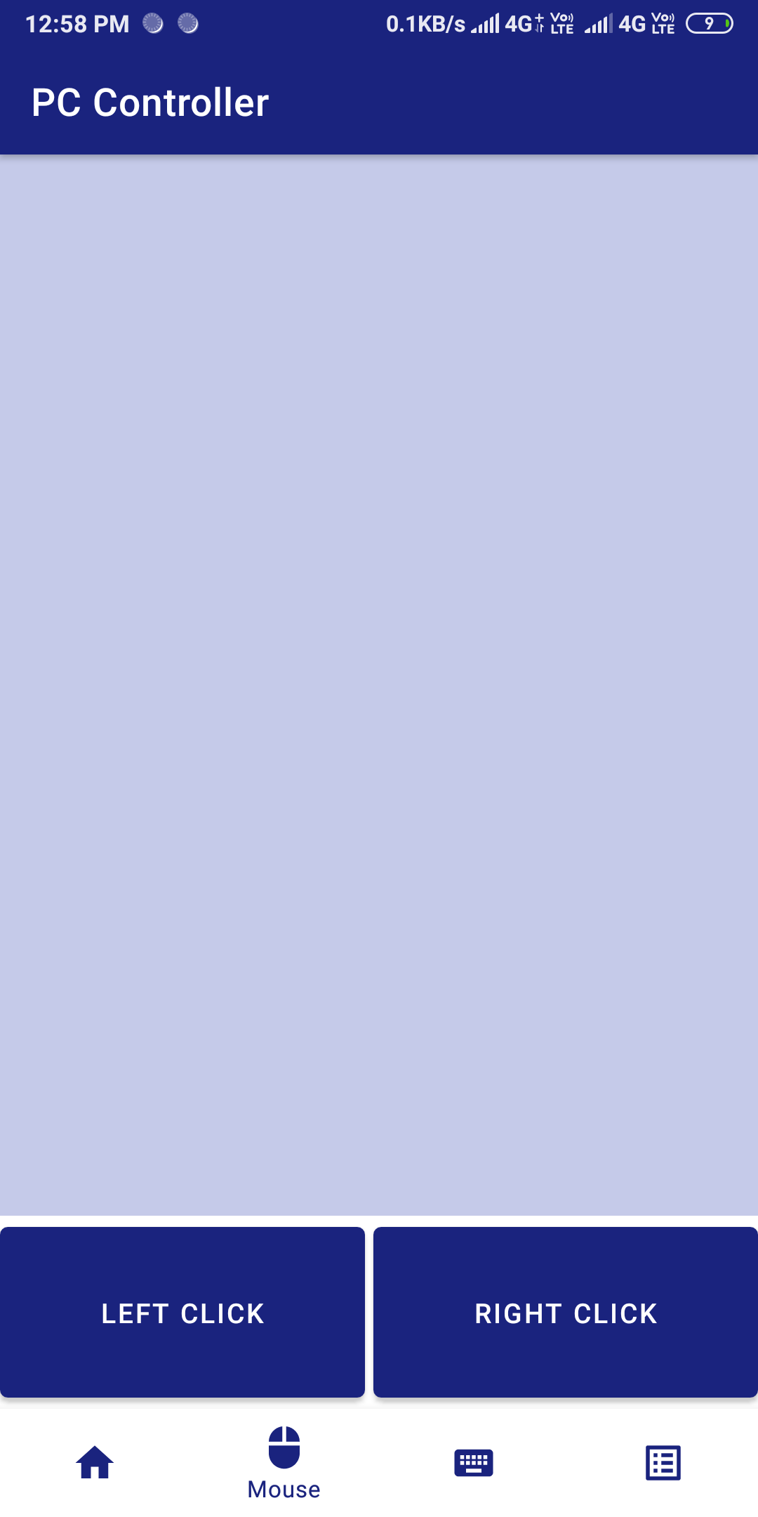
Touch screen Mouse

Slide 15
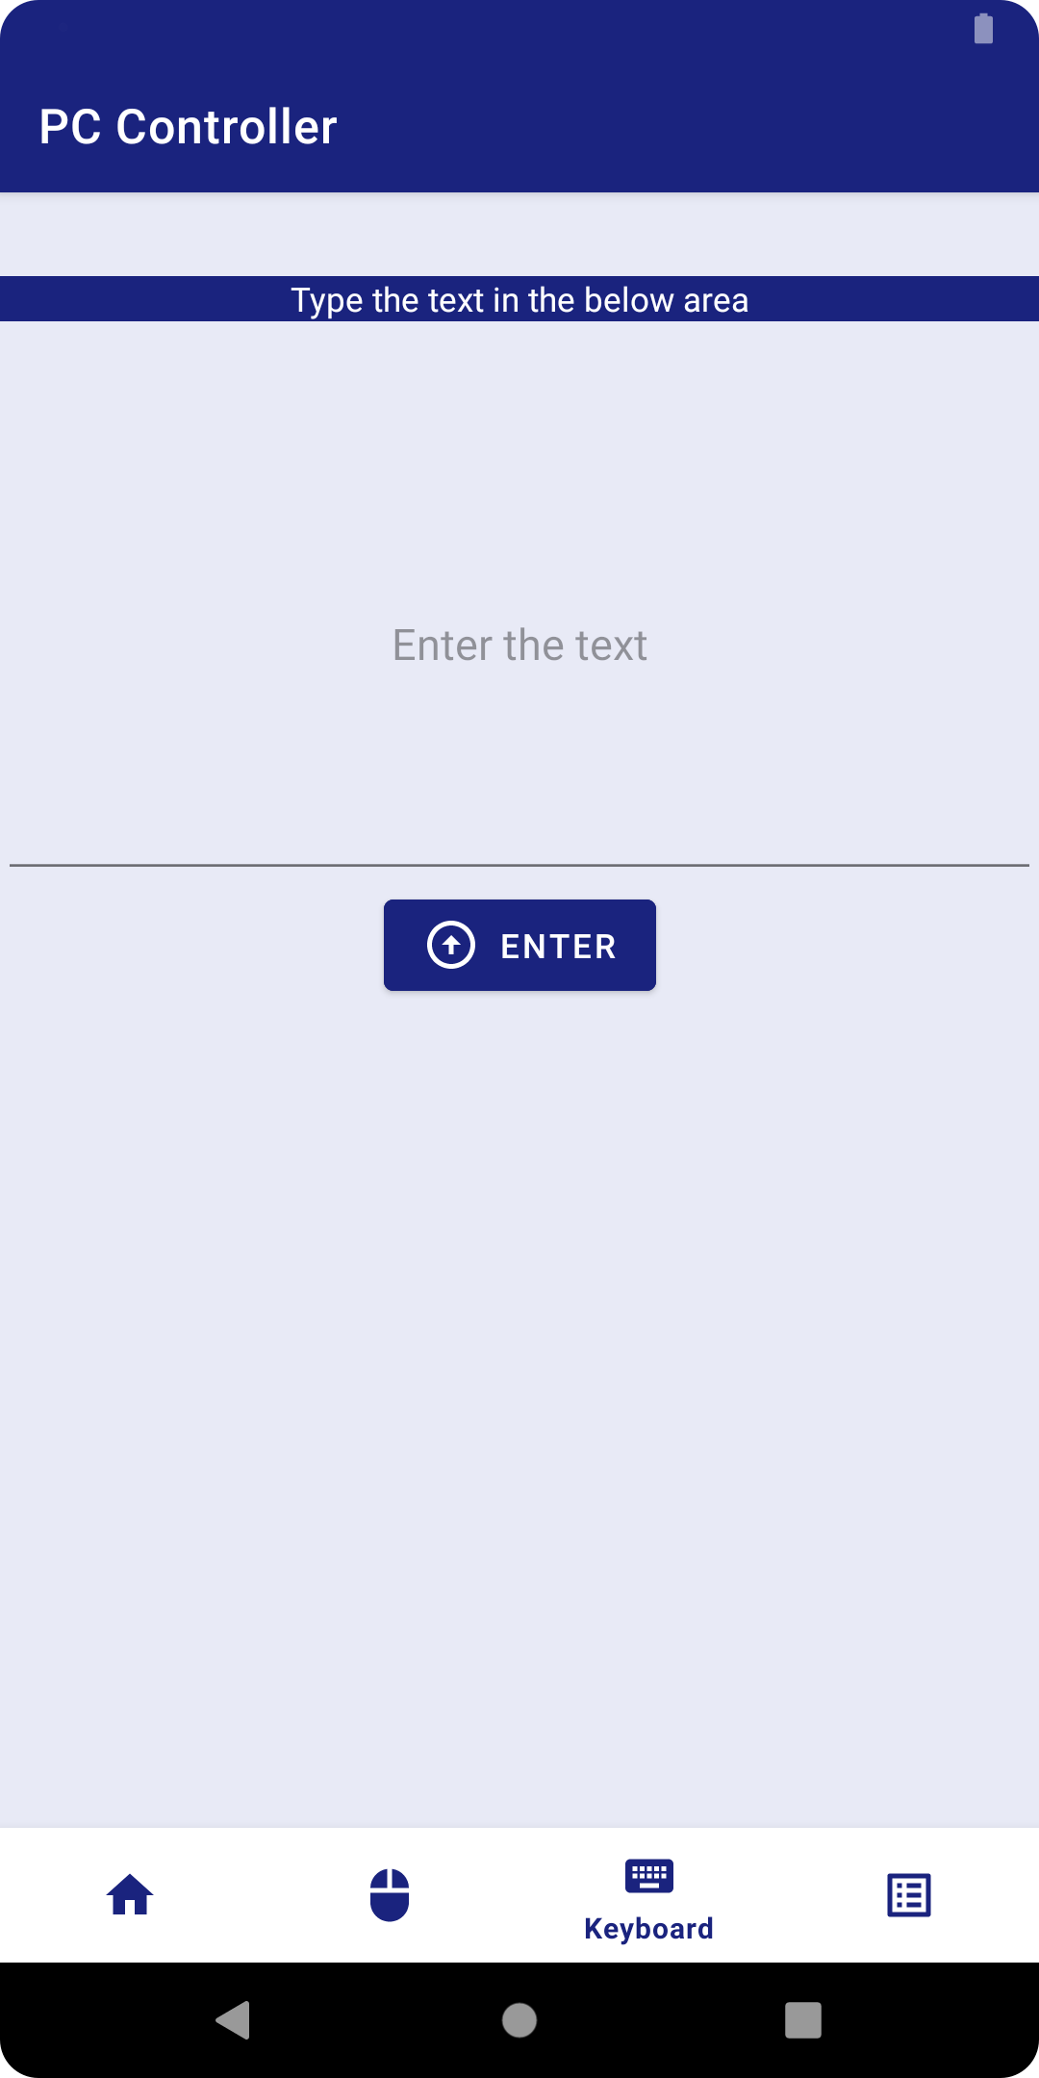

Slide 16
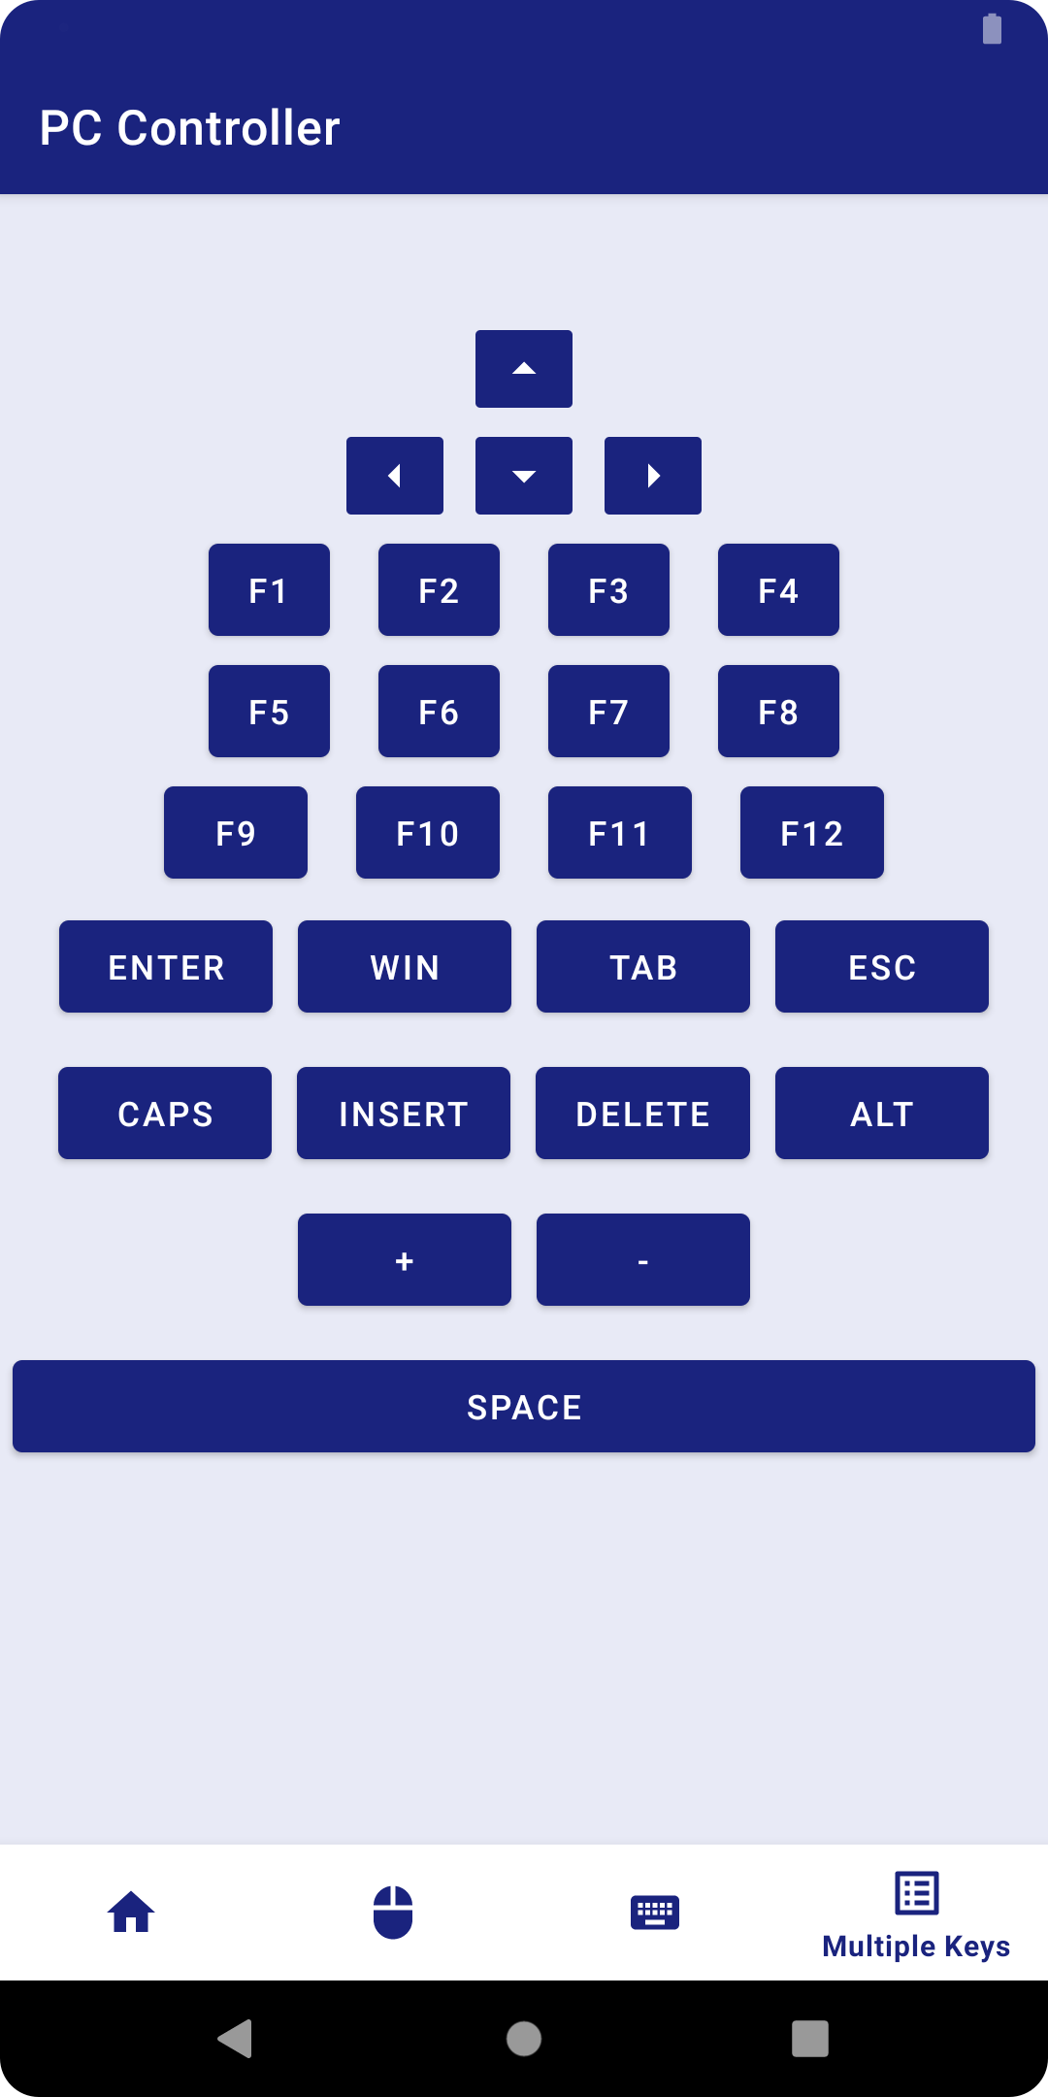

Slide 17
Future Scope
Our Team will be creating a Remote Access application for Android phones. This application will run on a mobile platform (Android). Which provides services for data transfer, file transfer and it has ability to view the remote location on android phones .For wireless connection Bluetooth as well as Wi-Fi are embedded to it.

Slide 18
Conclusion
This project explores the possibility of controlling the computer remotely using an Android phone device. The proposed prototype is able to control a lot of operations a normal computer keyboard and mouse would perform. It practically turns a mobile phone into a wireless keyboard and mouse using a wireless network via a portable mobile device running under an Android Operating System. It is proven that this project would relieve a pain in the neck and also the normal back ache due to constantly siting at a particular place. With the help of this prototype, these stressful moments will be minimized as users will be having a very relaxed position as intended. This is a convenient application for simple operations and for manipulating such computer without the keyboard and mouse been connected.

Slide 19
Thank you

